Slide 1

COMPUTER NETWORKS
Sivaraman Eswaran Ph.D.
Department of Computer Science and Engineering

Slide 2

COMPUTER NETWORKS
Computer Networks and the Internet
Sivaraman Eswaran Ph.D.
Department of Computer Science and Engineering

Slide 3

COMPUTER NETWORKS
Hosts: Send packets of data
Host sending function:
takes application message
breaks into smaller chunks, known as packets, of length L bits
transmits packet into access network at transmission rate R
link transmission rate, aka link capacity, aka link bandwidth
two packets,
L bits each
2
1
host
R: link transmission rate
packet
transmission
delay
time needed to
transmit L-bit
packet into link
L (bits)
R (bits/sec)
=
=

Slide 4
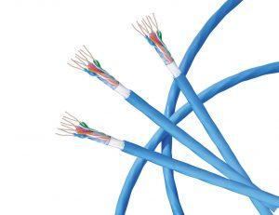
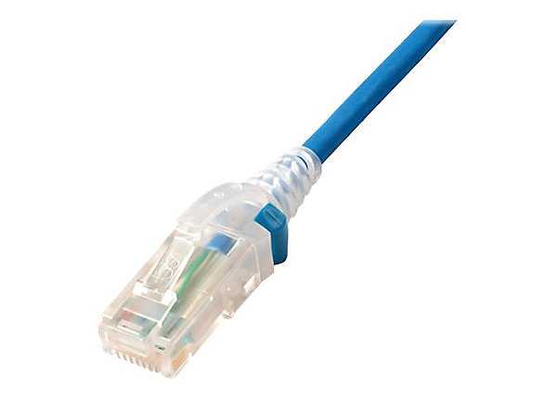
COMPUTER NETWORKS
Network Edge: Physical media
bit: propagates between transmitter/receiver pairs
physical link: what lies between transmitter & receiver
guided media:
signals propagate in solid media: copper, fiber, coax
unguided media:
signals propagate freely, e.g., radio
Twisted pair (TP)
two insulated copper wires
Category 5: 100 Mbps, 1 Gbps Ethernet
Category 6: 10Gbps Ethernet

Slide 5
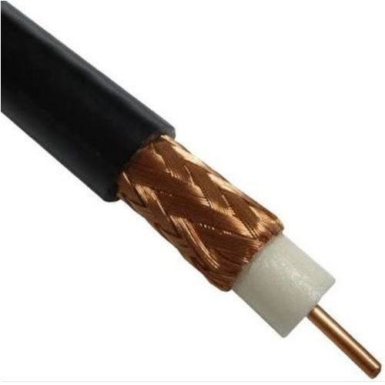
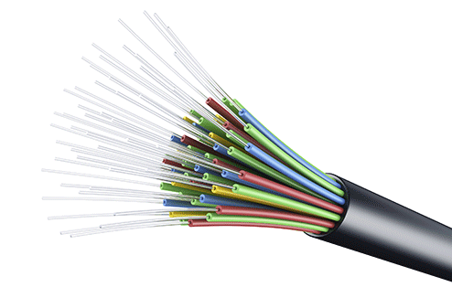
COMPUTER NETWORKS
Network Edge: Physical media
Coaxial cable:
two concentric copper conductors
bidirectional
broadband:
multiple frequency channels on cable
100’s Mbps per channel
Fiber optic cable:
glass fiber carrying light pulses, each pulse a bit
high-speed operation:
high-speed point-to-point transmission (10’s-100’s Gbps)
low error rate:
repeaters spaced far apart
immune to electromagnetic noise

Slide 6
COMPUTER NETWORKS
Network Edge: Physical media
Wireless radio
signal carried in electromagnetic spectrum
no physical “wire”
broadcast and “half-duplex” (sender to receiver)
propagation environment effects:
reflection
obstruction by objects
interference
Radio link types:
terrestrial microwave
up to 45 Mbps channels
Wireless LAN (WiFi)
Up to 100’s Mbps
wide-area (e.g., cellular)
4G cellular: ~ 10’s Mbps
satellite
up to 45 Mbps per channel
270 msec end-end delay
geosynchronous versus low-earth-orbit

Slide 7


COMPUTER NETWORKS
Queries

Slide 8
THANK YOU
Sivaraman Eswaran Ph.D.
Department of Computer Science and Engineering
sivaramane@pes.edu
+91 80 6666 3333 Extn 834

